Slide 1
Mapping of ER-diagram to Relational Schema

Slide 2
Outline
ER-to-Relational Mapping Algorithm
Step 1: Mapping of Regular/strong Entity Types
Step 2: Mapping of Weak Entity Types
Step 3: Mapping of Binary 1:1 Relationship Types
Step 4: Mapping of Binary 1:N Relationship Types.
Step 5: Mapping of Binary M:N Relationship Types.
Step 6: Mapping of N-ary Relationship Types.
Mapping EER Model Constructs to Relations
Step 7: Options for Mapping Specialization or Generalization.
Step 8: Mapping of Union Types (Categories).

Slide 3
Specifying Constraints in Data Models
ER model
domain and key constraints over entities
participation and cardinality constraints over relationships
Relational Model
domain constraints, entity identity, key constraint, functional dependencies -- generalization of key constraints, referential integrity, inclusion dependencies -- generalization of referential integrity.

Slide 4
ER to Relational Mapping
Example – Strong Entity Set
Strong Entity
Relation:
Employee(ssno, name, salary)
Key : ssno
ssno
name
salary
employee
CREATE TABLE Employees
( ssn CHAR(11),
name CHAR(20),
salary INTEGER,
PRIMARY KEY (ssn)
);

Slide 5
SID
Name
SSN
Name
Student
Advisor
Professor
N
1
Major
Dept
GPA
SID | Name | Major | GPA
1234 | John | CS | 2.8
5678 | Mary | EE | 3.6
SSN | Name | Dept
9999 | Smith | Math
8888 | Lee | CS

Slide 6
Representing Composite Attribute
Each component will become the simple attribute.
Compared to composite attribute, simple attribute improve accessibility & facilitate the data quality.
NO column for the composite attribute itself
SSN
Name
SSN | Name | Street | City
9999 | Dr. Smith | 50 1st St. | Fake City
8888 | Dr. Lee | 1 B St. | San Jose
Professor
Address
Street
City

Slide 7
Representing Multivalue attribute
Two new relations are created.
First will contain all attribute except multivalued.
Second will contain two attribute Pk of first and multivalued attribute.
SID
Name
Children
The primary key for this table is Student_SID + Children, the union of all attributes
Phd_stud
Major
GPA
Stud_SID | Children
1234 | Johnson
1234 | Mary
5678 | Bart
5678 | Lisa
5678 | Maggie
SID | Name | Major | GPA
1234 | John | CS | 2.8
5678 | Homer | EE | 3.6

Slide 8
Representation of Weak Entity Set
Weak Entity Set Cannot exists alone
To build a table/schema for weak entity set
Construct a table with one column for each attribute in the weak entity set
Remember to include discriminator
Augment one extra column on the right side of the table, put in there the primary key of the Strong Entity Set (the entity set that the weak entity set is depending on)
Primary Key of the weak entity set = Discriminator + foreign key(primary key of the Strong Entity Set)

Slide 9
Example – Weak Entity Set
Age
SID
Name
Name
Phd_Stud
owns
Children
Major
GPA
Age | Name | Parent_SID
10 | Bart | 1234
8 | Lisa | 5678
* Primary key of Children is Parent_SID + Name

Slide 10
Representation of Relationship Set
Unary/Binary Relationship set
Depends on the cardinality and participation of the relationship
Two possible approaches
N-ary (multiple) Relationship set
Primary Key Issue
Identifying Relationship
No relational model representation necessary

Slide 11
Representing Relationship Set
Unary or Binary Relationship
1. For one-to-one relationship without total participation
Build a table with two columns, one column for each participating entity set’s primary key.
Add successive columns, one for each descriptive attributes of the relationship set (if any).

Slide 12
Example – One-to-One Relationship Set
Degree
SID
Name
ID Code
Student
study
Major
Major
GPA
SID | Maj_ID Code | S_Degree
9999 | 07 | 1234
8888 | 05 | 5678
* Primary key can be either SID or Maj_ID_Co

Slide 13
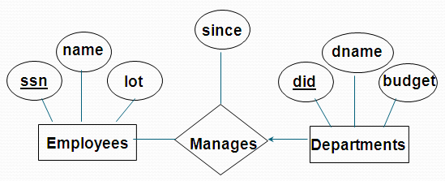
Each dept has at most one manager, according to the key constraint on Manages.
Translation to
relational model?
1-to-1
1-to Many
Many-to-1
Many-to-Many
Notes:
6

Slide 14
Translating ER Diagrams
Map relationship to a table:
Note that did is the
key now!
Separate tables for Employees and Departments.
CREATE TABLE Manages(
ssn CHAR(11),
did INTEGER,
since DATE,
PRIMARY KEY (did),
FOREIGN KEY (ssn) REFERENCES Employees(ssn),
FOREIGN KEY (did) REFERENCES Departments(did));
Notes:
7
Department manager contains information in both departments and manages
Pro: eliminates relation (the Departments table)
Con: wastes space if not all departments have managers
Set up and illustrate in SQL Server.

Slide 15
For one-to-one relationship with one entity set having total participation
Augment one extra column on the right side of the table of the entity set with total participation
put in there the primary key of the entity set without complete participation as per to the relationship.

Slide 16
Example – One-to-One Relationship Set
1: 1 Relationship
Condition
SID
Name
S/N #
Student
Have
Laptop
Major
GPA
Brand
SID | Name | Major | GPA | LP_S/N | Hav_Cond
9999 | Bart | Economy | -4.0 | 123-456 | Own
8888 | Lisa | Physics | 4.0 | 567-890 | Loan
* Primary key can be either SID or LP_S/N

Slide 17
2. For one-to-many relationship w/out total participation
Same thing as one-to-one
3. For one-to-many/many-to-one relationship with one entity set having total participation on “many” side
Augment one extra column on the right side of the table of the entity set on the “many” side,
put in there the primary key of the entity set on the “one” side (as foreign key) as per to the relationship.

Slide 18
Example – Many-to-One Relationship Set
SID
Name
Semester
SSN
N: 1 Relationship
Student
Advisor
Professor
Major
GPA
Dept
Name
SID | Name | Major | GPA | Pro_SSN | Ad_Sem
9999 | Bart | Economy | -4.0 | 123-456 | Fall 2006
8888 | Lisa | Physics | 4.0 | 567-890 | Fall 2005
* Primary key of this table is SID

Slide 19
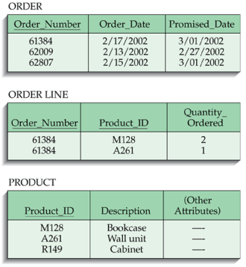
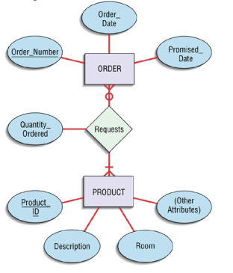
4. M:N relationships
Create another relation and include primary keys of all relations as primary key of new relation

Slide 20
Representing Relationship Set N-ary Relationship
Build a new table with as many columns as there are attributes for the union of the primary keys of all participating entity sets.
Augment additional columns for descriptive attributes of the relationship set (if necessary)
The primary key of this table is the union of all primary keys of entity sets that are on “many” side

Slide 21
Example – N-ary Relationship Set
P-Key1
D-Attribute
A-Key
E-Set 1
P-Key2
A relationship
Another Set
E-Set 2
P-Key3
E-Set 3
P-Key1 | P-Key2 | P-Key3 | A-Key | D-Attribute
9999 | 8888 | 7777 | 6666 | Yes
1234 | 5678 | 9012 | 3456 | No
* Primary key of this table is P-Key1 + P-Key2 + P-Key3

Slide 22
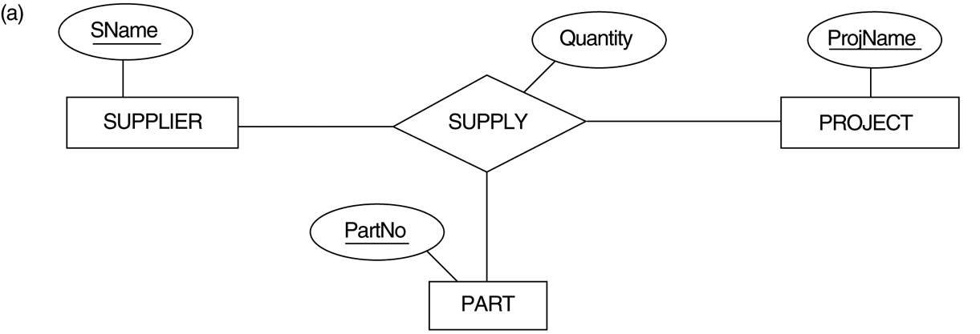
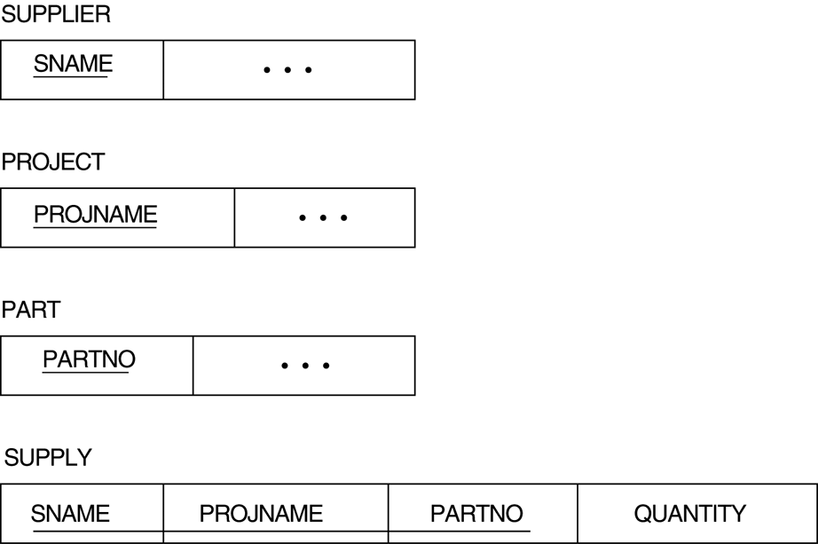
Ternary relationship types. (a) The SUPPLY relationship.

Slide 23
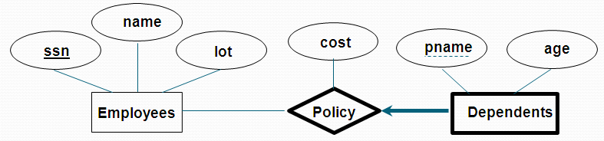
Mapping Identifying Relationship
Weak entity set and identifying relationship set are translated into a single table.
When the strong entity is deleted, all owned weak entities must also be deleted.
CREATE TABLE Dep_Policy (
pname VARHAR(20),
age INTEGER,
cost REAL,
ssn VARCHAR(11),
PRIMARY KEY (pname, ssn),
FOREIGN KEY (ssn) REFERENCES Employees(ssn));

Slide 24
Mapping EER Model Constructs to Relations
For non-disjoint and/or non-complete class hierarchy:
create a table for each super class entity set according to normal entity set translation method.
Create a table for each subclass entity set with a column for each of the attributes of that entity set plus one for each attributes of the primary key of the super class entity set
This primary key from super class entity set is also used as the primary key for this new table

Slide 25
Example
SSN
Name
Person
SID
Status
Gender
U
O
Student
Superclass
Major
GPA
SSN | Name | Gender
1234 | Homer | Male
5678 | Marge | Female
Subclass
SSN | SID | Status | Major | GPA
1234 | 9999 | Full | CS | 2.8
5678 | 8888 | Part | EE | 3.6

Slide 26
For disjoint AND complete mapping class hierarchy:
The participation from the superclass is complete
DO NOT create a table for the super class entity set
Create a table for each subclass entity set include all attributes of that subclass entity set and attributes of the superclass entity set

Slide 27
Example
SSN
Name
No table created for superclass entity set
people
d
SID
Student
Faculty
Disjoint and Complete mapping
Major
GPA
Dept
SSN | Name | SID | Major | GPA
1234 | John | 9999 | CS | 2.8
5678 | Mary | 8888 | EE | 3.6
SSN | Name | Dept
1234 | Homer | C.S.
5678 | Marge | Math

Slide 28
Union Type
Step 9: Mapping of Union Types
(Categories).
For mapping a category whose defining superclass
have different keys, it is customary to specify a new
key attribute, called a surrogate key, when creating a
relation to correspond to the category.
In the example below we can create a relation
OWNER to correspond to the OWNER category and
include any attributes of the category in this relation.
The primary key of the OWNER relation is the
surrogate key, which we called OwnerId.

Slide 29
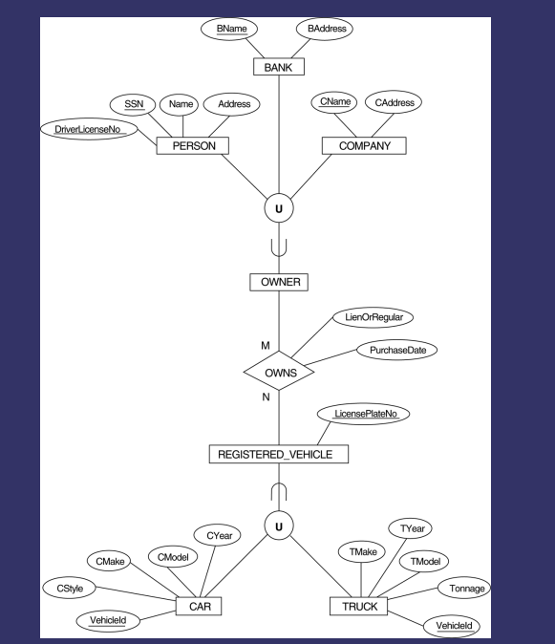
Example

Slide 30
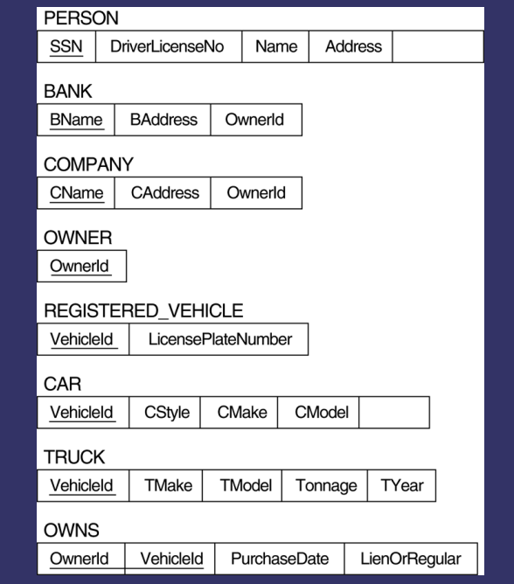
Solution

Slide 31
Summary of Mapping constructs and constraints
Correspondence between ER and Relational Models
ER Model Relational Model
Entity type “Entity” relation
1:1 or 1:N relationship type Foreign key (or “relationship” relation)
M:N relationship type “Relationship” relation and two foreign keys
n-ary relationship type “Relationship” relation and n foreign keys
Simple attribute Attribute
Composite attribute Set of simple component attributes
Multivalued attribute Relation and foreign key
Value set Domain
Key attribute Primary (or secondary) key

Slide 32
Relational Model: Summary
A tabular representation of data.
Simple and intuitive, currently the most widely used.
Integrity constraints can be specified by the DBA, based on application semantics. DBMS checks for violations.
Two important ICs: primary and foreign keys
In addition, we always have domain constraints.
Powerful and natural query languages exist.
Rules to translate ER to relational model
Notes:
15

Slide 33
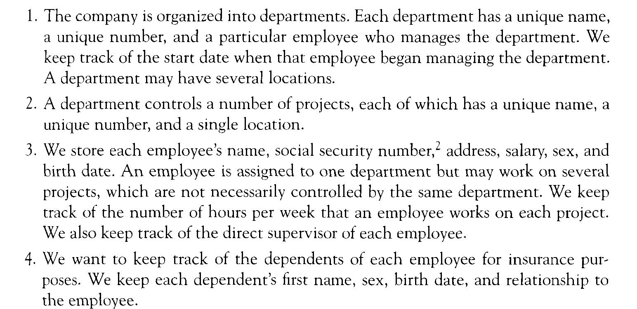
Draw ER diagram

Slide 34
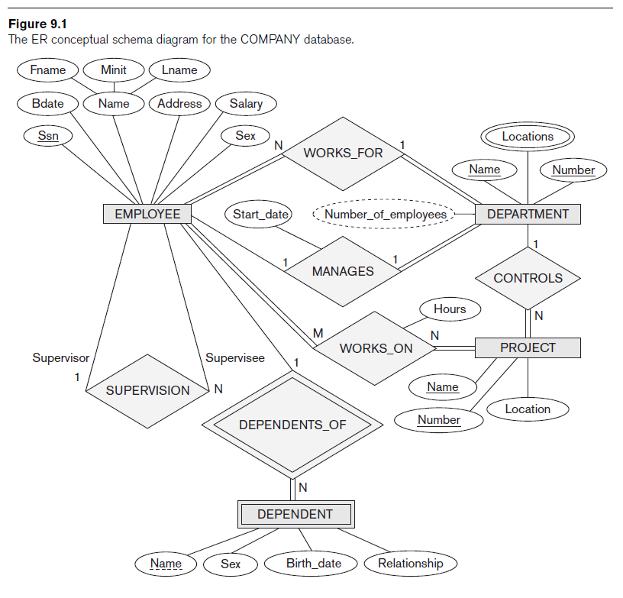

Slide 35
